Slide 1


Slide 2
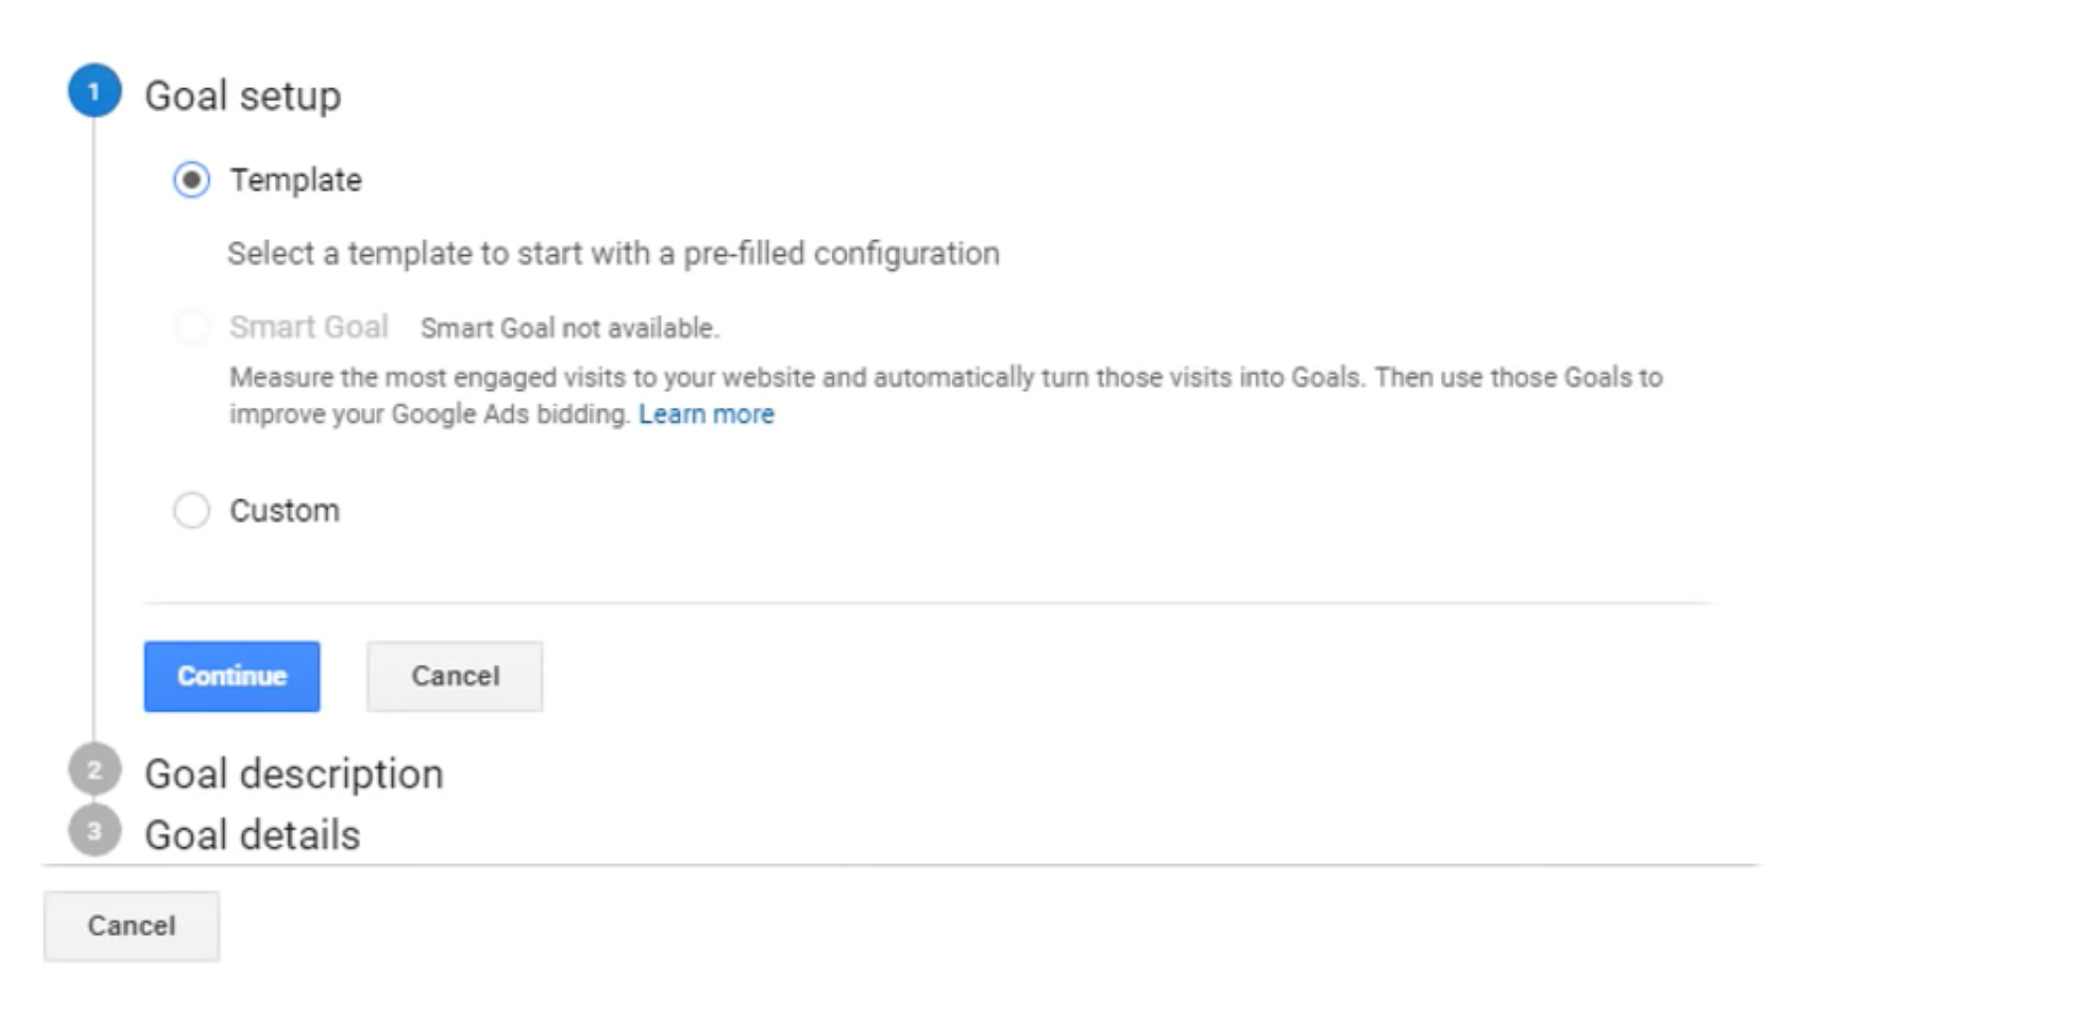

Slide 3
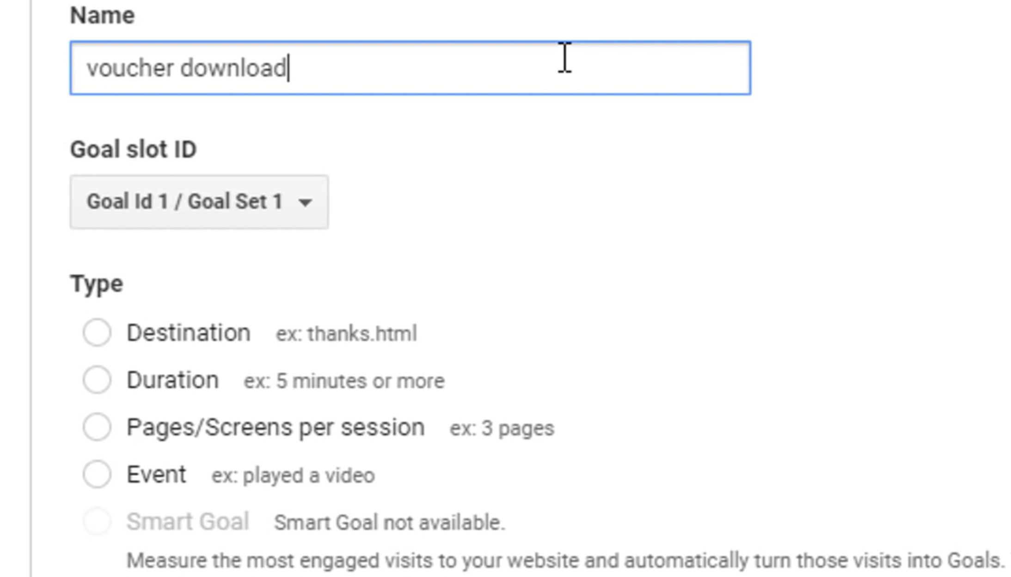

Slide 4
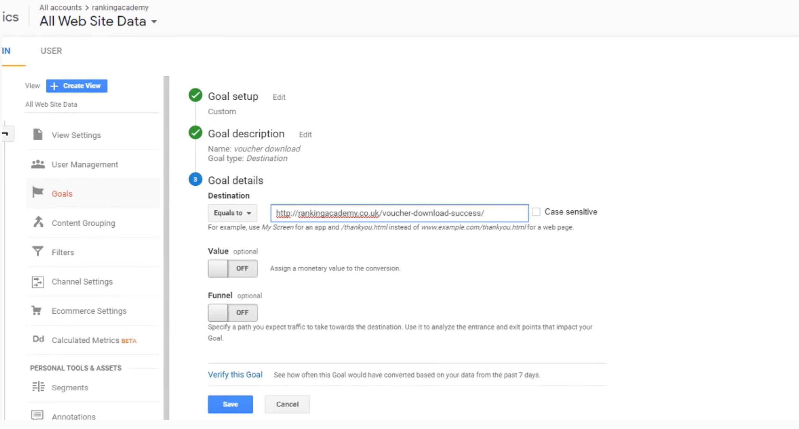

Slide 5
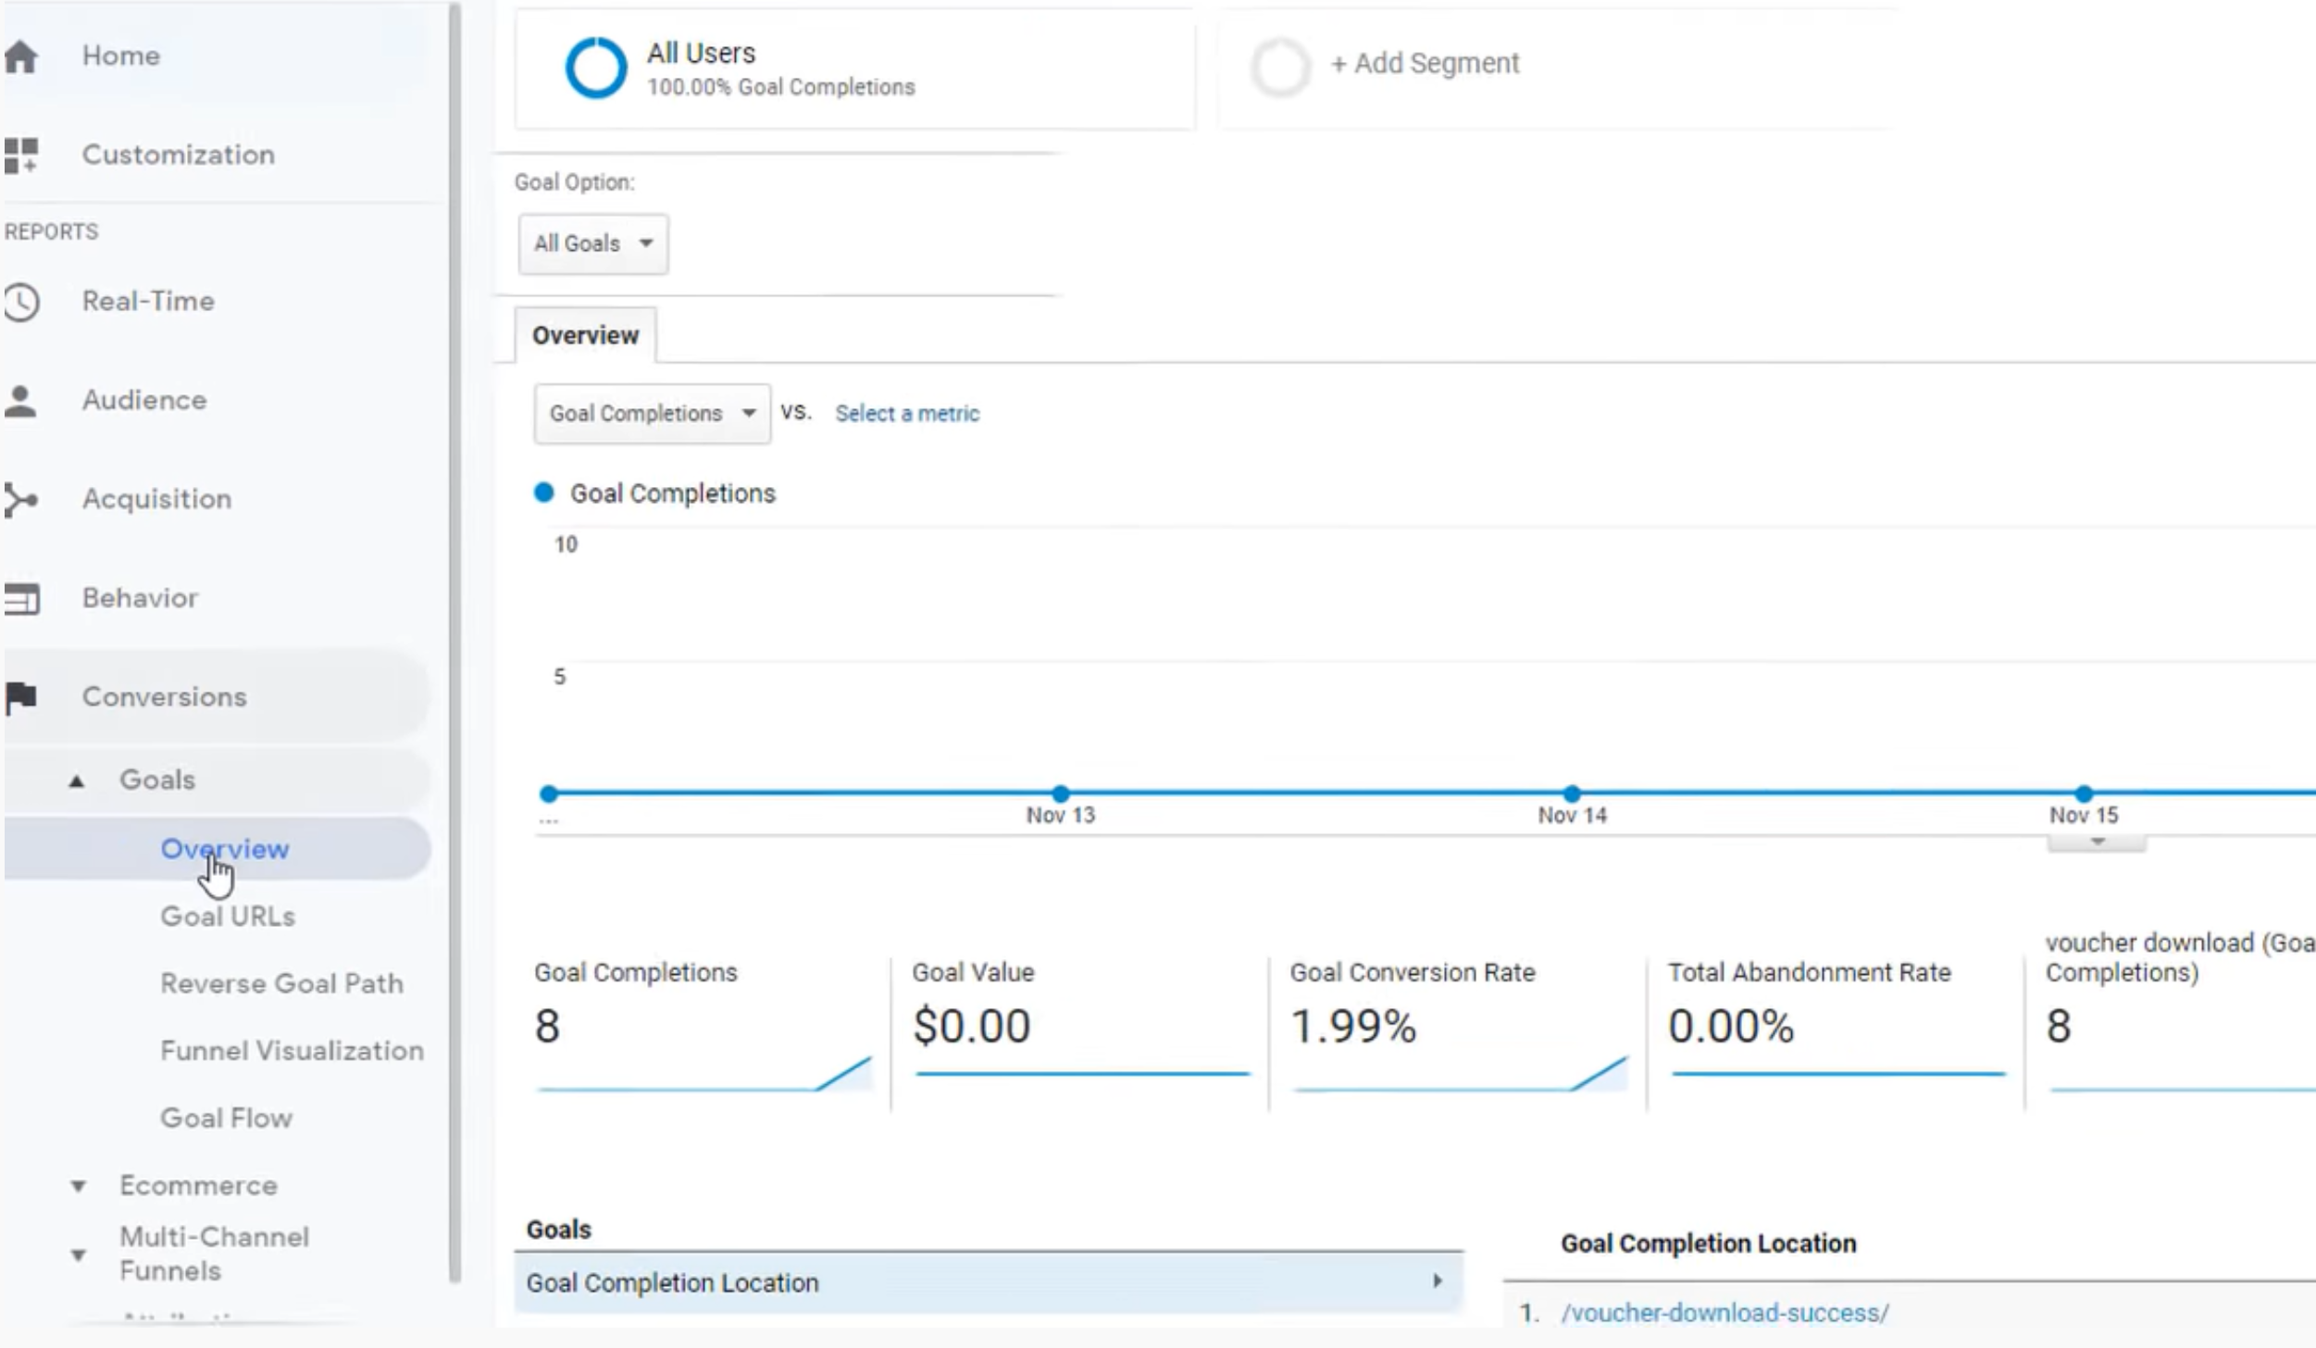

Slide 6
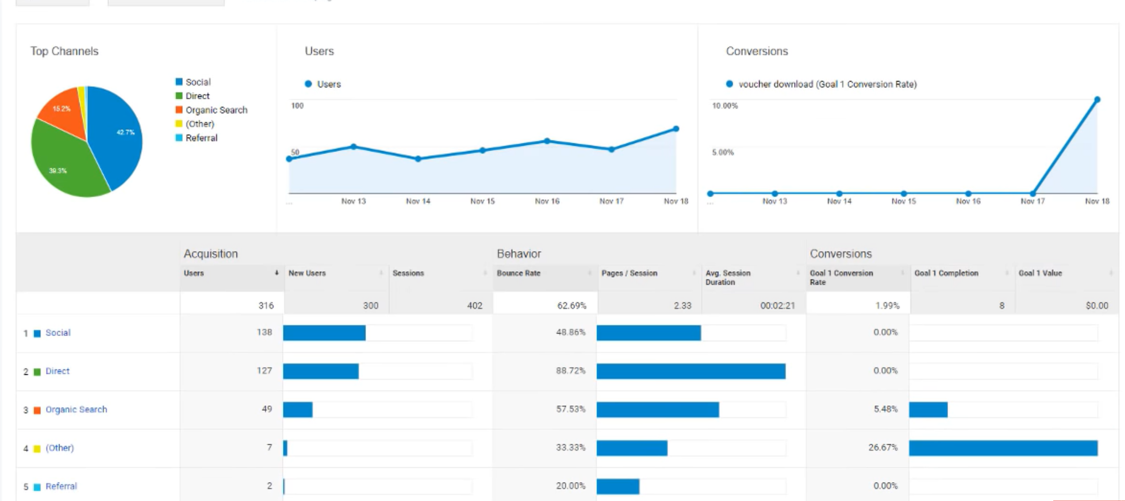
Acquisition - Overview

Slide 7


Slide 8
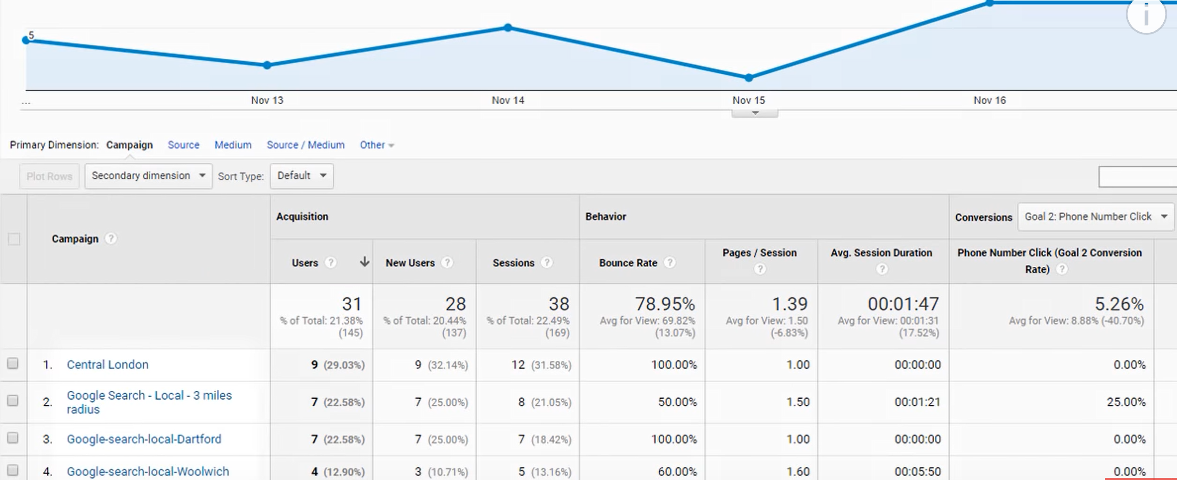
Acquisition- Campaign – All Campaign

Slide 9
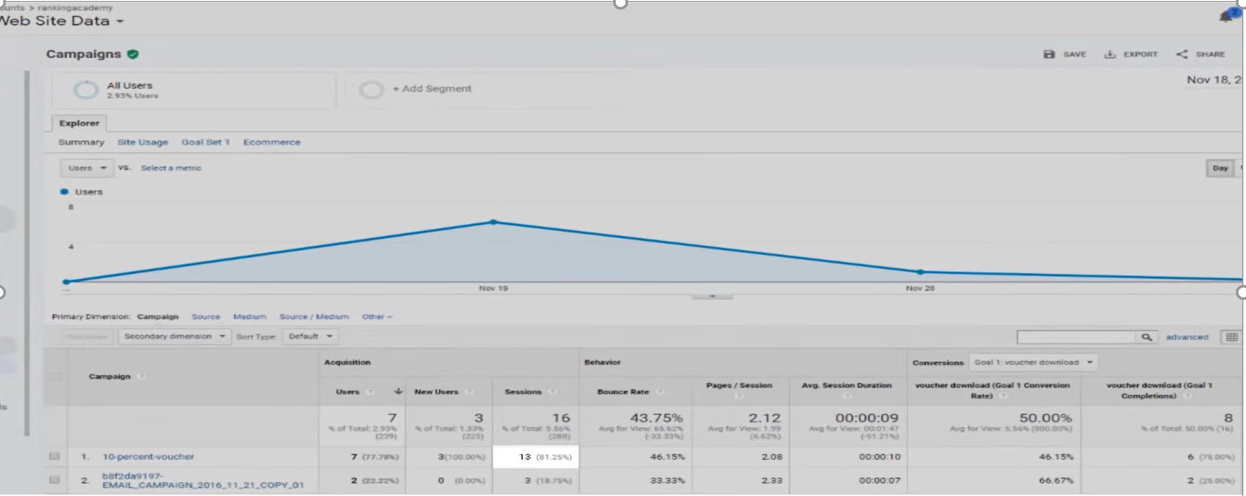
Campaign URL Builder (Google Search)

Slide 10
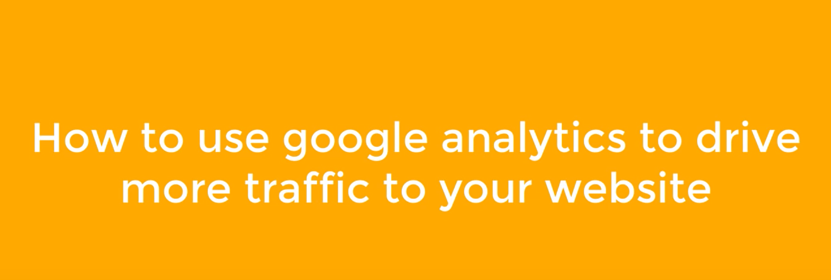

Slide 11
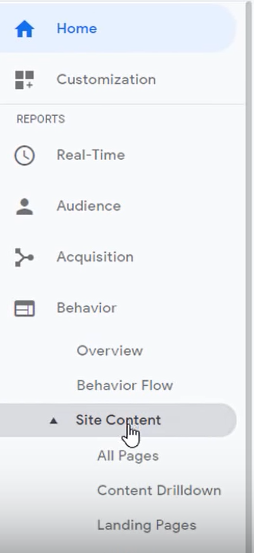
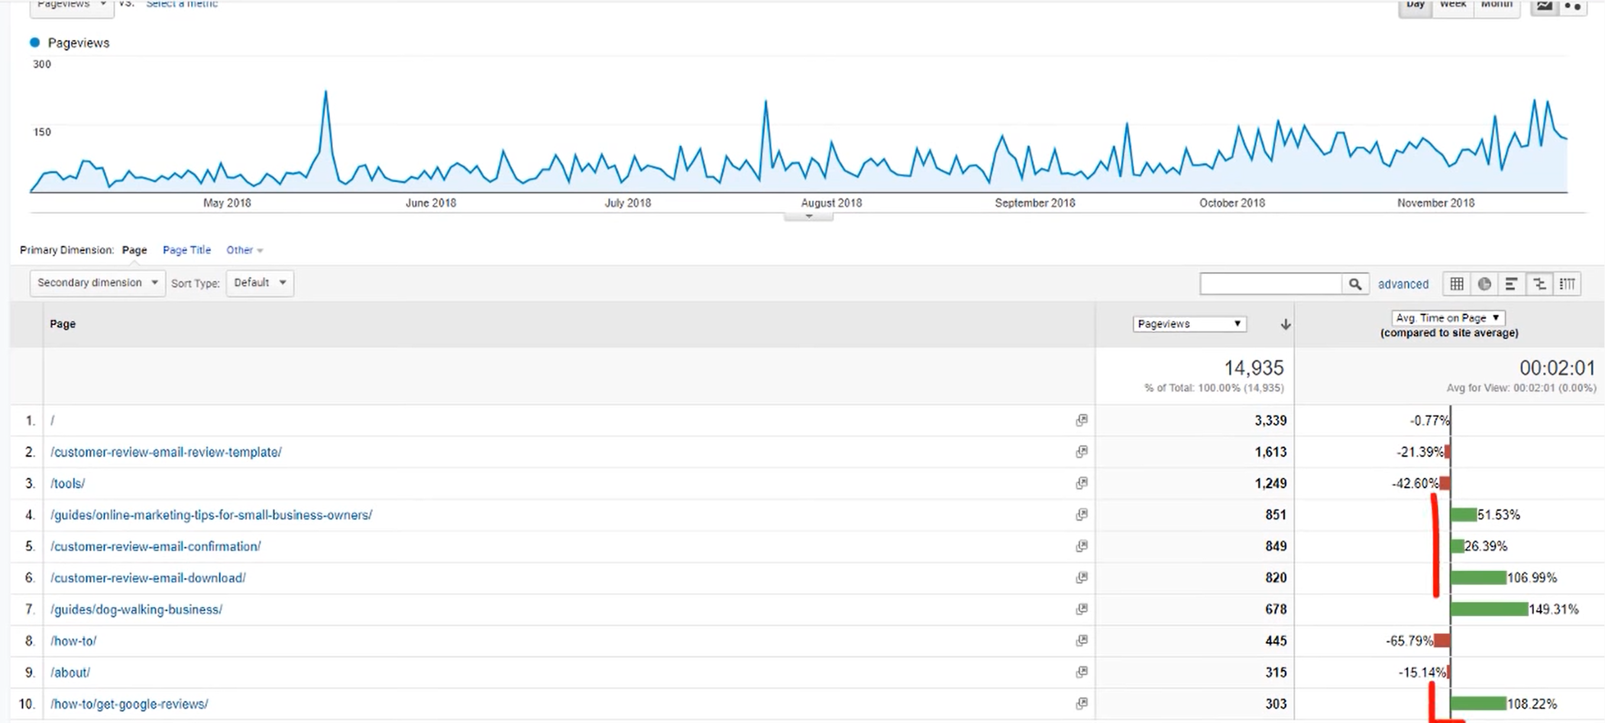
Find your best pages and create more of the same

Slide 12
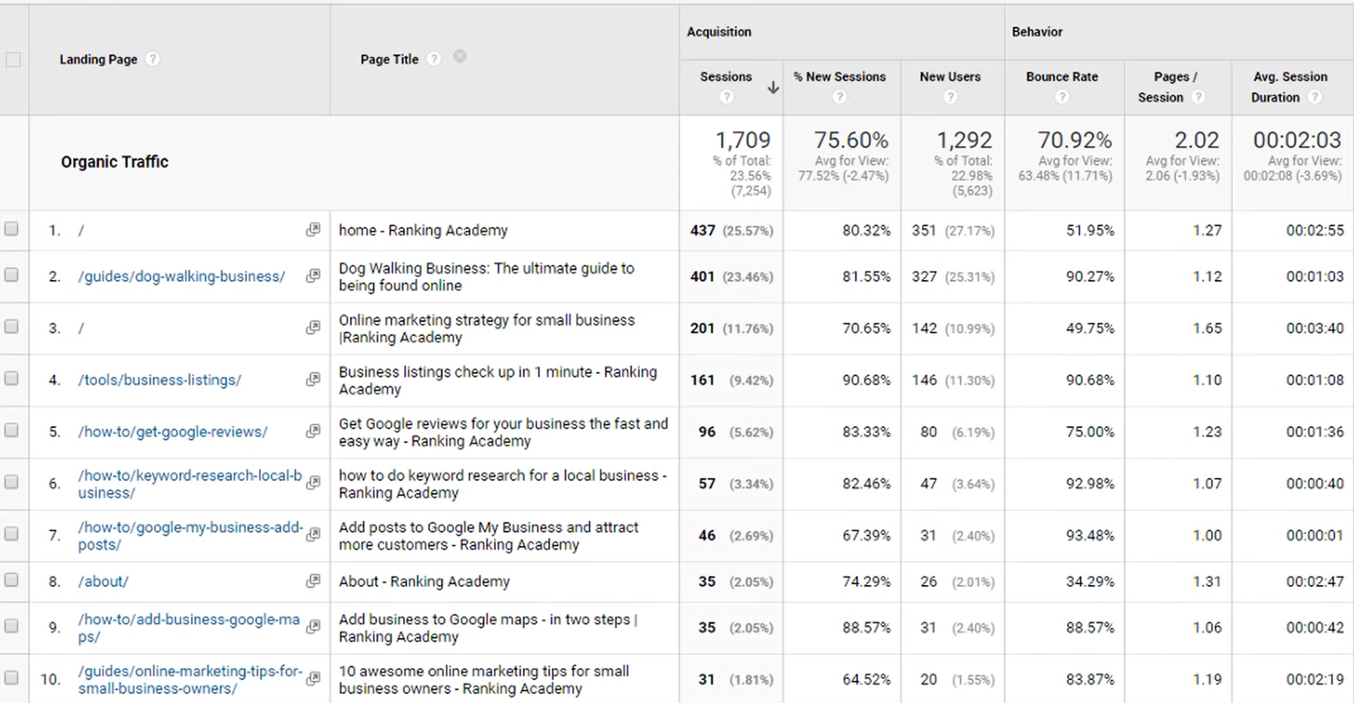
Improve your organic traffic by page title
Behaviour – Site Traffic – Landing Pages
Right Click and Add Segments
Secondary Dimension – Page title

Slide 13
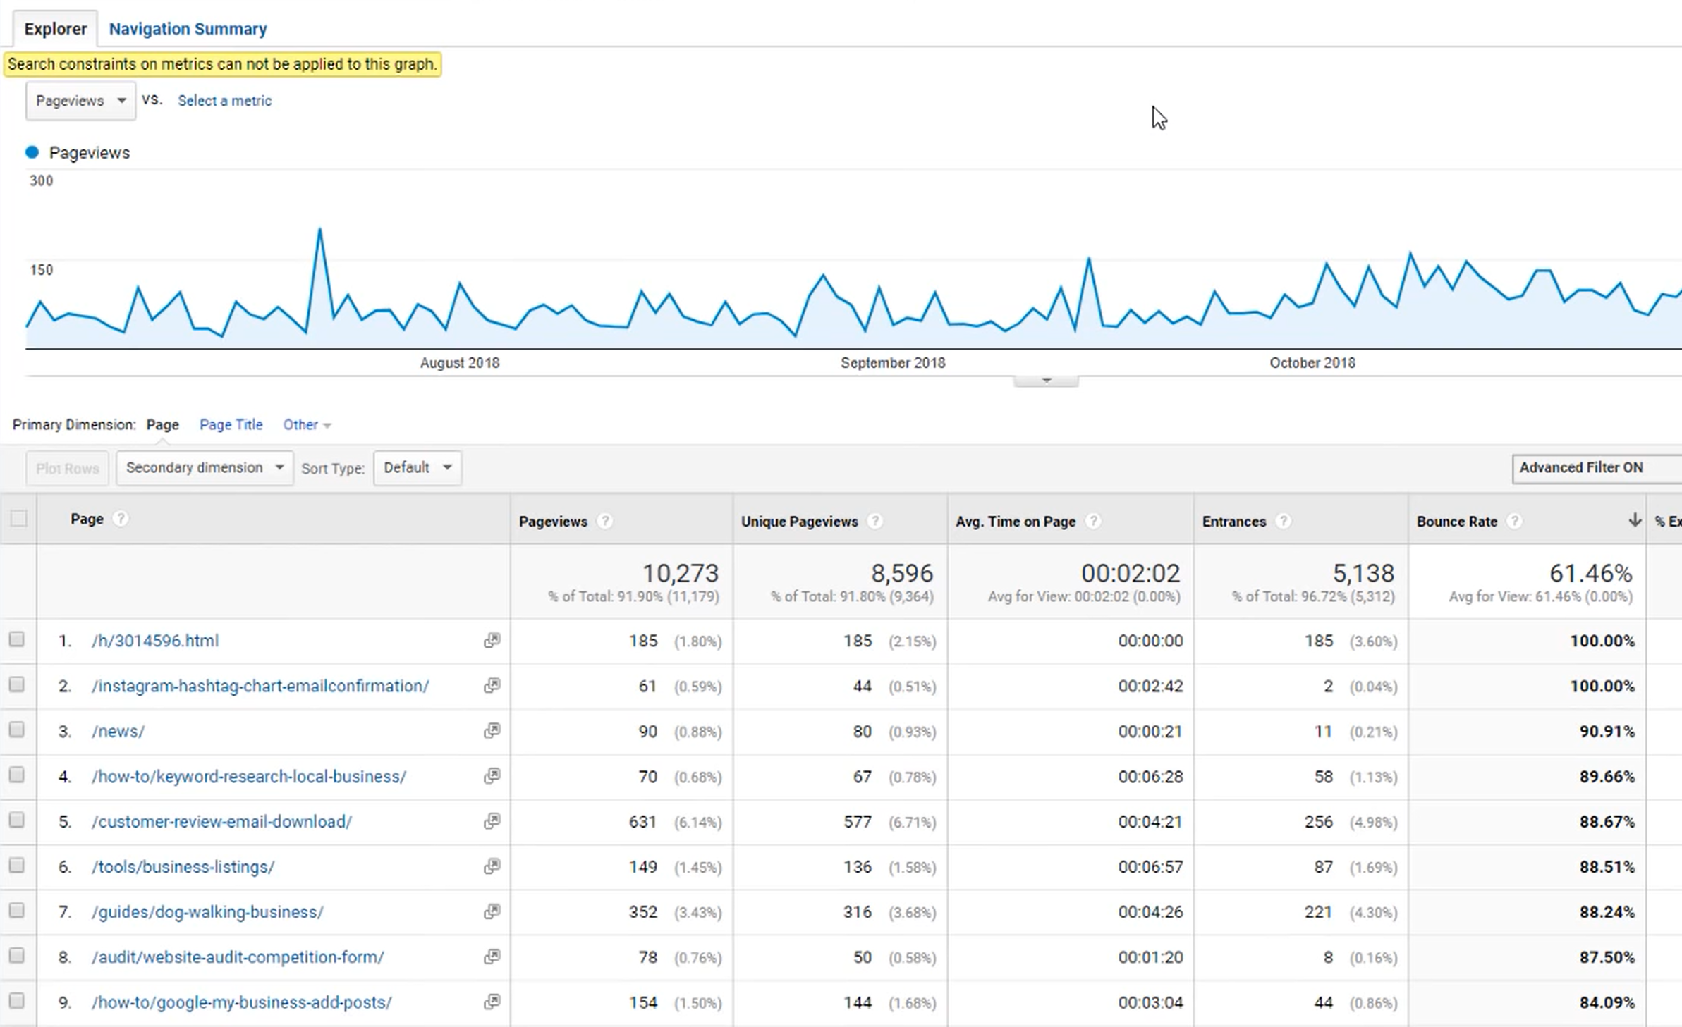
Lower Bounce rate
Behaviour – Site Traffic – All Pages
Advance options – Page views

